Slide 1

Center for Development of Advanced Computing Patna
Image Captioning: Transforming Objects into Text
By
Patil Sumit (PRN No.:220980728007)
Bhise Aditya (PRN No.: 220980728004)
Patil Rahul (PRN No.: 220980728003)
Kumari Megha (PRN No.: 220980728002)
Guided By
Swami Aditya Nath

Slide 2
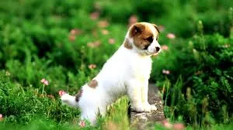
What do you see in the below picture?

Slide 3
Problem Statement
To develop an image captioning algorithm that can accurately and coherently describe the content of any given image, even in the presence of complex and ambiguous scenes. The solution should be robust and able to generalize to output with the potential to improve the lives of visually impaired individuals, enhance image retrieval, and create more engaging and descriptive content.

Slide 4
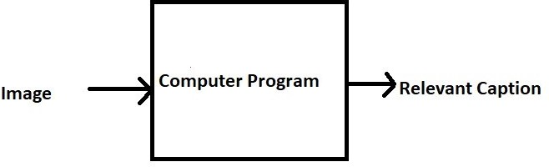
Goal
• Just prior to the recent development of Deep Neural Networks captioning an image was inconceivable even by the most advanced researchers in Computer Vision. But with the advent of Deep Learning this problem can be solved very easily if we have the required dataset.
• Deep Learning can be used to solve this problem of generating a caption for a given image, hence the name Image Captioning.

Slide 5
Application
Self driving cars
Visual Aid for the blind - Guide them while travelling
Image Search - Search an image based on its caption
Automatic Surveillance - CCTV Cameras

Slide 6
Perquisites
Neural Networks ( Multilayer Perceptron, Convolutional Neural Networks, Recurrent Neural Networks)
Language Model ( Natural Language Processing )
Python syntax and data structures
Libraries like keras, tensorflow, numpy, pandas, etc.

Slide 7
Steps Involved
Data Collection
Data Cleaning-Data preprocessing (Captions and Images)
Data Preparation using generator function
Prediction
Model Architecture

Slide 8
Data Collection
Dataset used in project
Flickr 8k - 5 captions for each image
Training Set — 6000 images
Dev Set — 1000 images
Test Set — 1000 images
Popular Datasets
Flickr 8k (containing 8k images)
!wget https://github.com/jbrownlee/Datasets/releases/download/Flickr8k/Flickr8k_Dataset.zip
!wget https://github.com/jbrownlee/Datasets/releases/download/Flickr8k/Flickr8k_text.zip

Slide 9
Flow Chart
Problem Statemen
Start
Flickr_8k
Fetch image from dataset
Pre- processing
Apply model
Input Image
Image Captioning
End

Slide 10
Data Cleaning
We performed some basic cleaning on text(captions) like lower- casting all words, removing special tokens and numbers.
Create a vocabulary of all unique words present across the 40000 captions.
We consider only those words that occur at least 10 times in the entire corpus of 40000 captions.
Reducing the vocabulary size results in less overfitting and less computation.
Total Words - 373837 Unique Words - 8424
Filtered Unique Words - 1845

Slide 11
Data Pre-processing (Images)
Input to our model is an image. We convert every image into a fixed sized vector which can be fed as input to the neural network.
For this purpose, we opt for transfer learning by using ResNet-50 model ( pre-trained model ). This model was trained on Imagenet dataset to perform image classification. We just remove the last softmax layer from the model and extract the feature vector for every image.
We pass every image to this model to get the corresponding feature vector. A dictionary named “encoding_train” maps the image_id(key) to the feature vector(value).
Similarly, we create a dictionary “encoding_test” for test images.

Slide 12
Data Pre-processing (Caption)
We represent each unique word in the vocabulary by an integer(index).
All the 1845 unique words in the corpus will be represented by an integer between 1 and 1845.
We also calculate the maximum length of a caption (35 - for our dataset).

Slide 13
Data Preparation
We give an image as input to the model and expect a caption (or sentence) as output.
But, the model cannot generate entire sentence at once.
We also provide a partial caption as input to the model along with the image. A single word in the vocabulary is given as output which is appended to the partial caption and fed to the model again. Like this, we generate the entire sentence or caption.

Slide 14
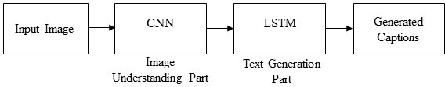
Architecture
A convolution neural network that encodes an image into a compact representation, followed by a recurrent neural network that generates a corresponding sentence.
Global image features are extracted from the hidden activations of CNN
Image features are fed into an LSTM to generate a sequence of words

Slide 15
Building The Model
Our image captioning architecture consists of three models:
A CNN: used to extract the image features
A TransformerEncoder: The extracted image features are then passed to a Transformer based encoder that generates a new representation of the inputs
A TransformerDecoder: This model takes the encoder output and the text data (sequences) as inputs and tries to learn to generate the caption.

Slide 16
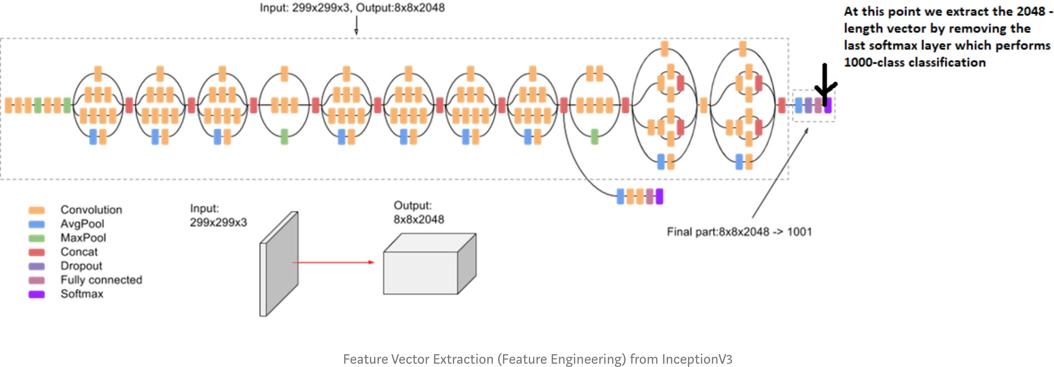
Feature extraction of Images

Slide 17
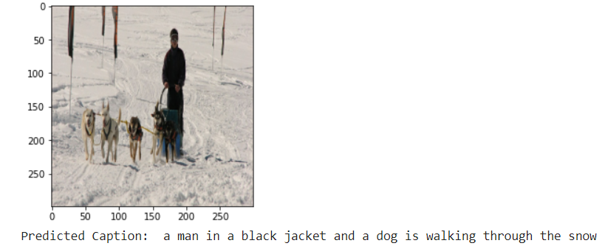
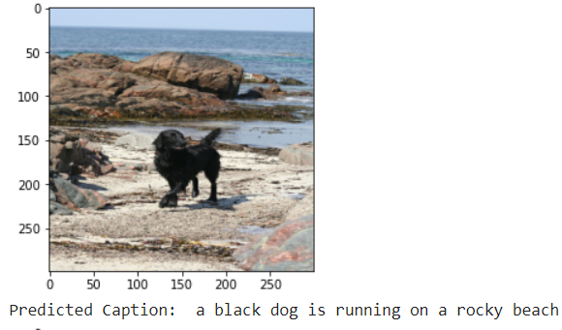
Prediction

Slide 18
References
https://cs.stanford.edu/people/karpathy/cvpr2015.pdf
https://arxiv.org/abs/1411.4555
https://towardsdatascience.com/image-captioning-with- keras-teaching-computers-to-describe-pictures- c88a46a311b8
https://towardsdatascience.com/how-to-easily-deploy- machine-learning-models-using-flask-b95af8fe34d4

Slide 19
Thank You
Thank you

